Slide 1
ENTERTAINMENT ANALYSIS
DONE BY :
Abinaya T

Slide 2
INTRODUCTION
Normal life can be stressful, and people need to relax. Being entertained by others is a wonderful way to take some time out of life. It can reduce stress and make life's issues easier to face.
The media and entertainment industry consists of film, television, radio and print. These segments include movies, TV shows, radio shows, news, music ,newspapers, magazines, and books.
The entertainment industry is a group of sub-industries devoted to entertainment.
The entertainment industry is used to describe the mass media companies that control the distribution and manufacture of mass media entertainment.

Slide 3
DETAILS OF DATA
The data set consists of BASIC INFO,BREAKTHROUGH INFO,LAST WORK INFO.
And I had added some additional columns to get proper insight from the data.

Slide 4
MAIN KPIS
Total Nominees - Person selected as nominees for award.
Total award - person win the award.
Top Actors - who won high number of award for acting.
Top singers - who won high number of award for singing.

Slide 5
MY DESIGN of dashboard

Slide 6
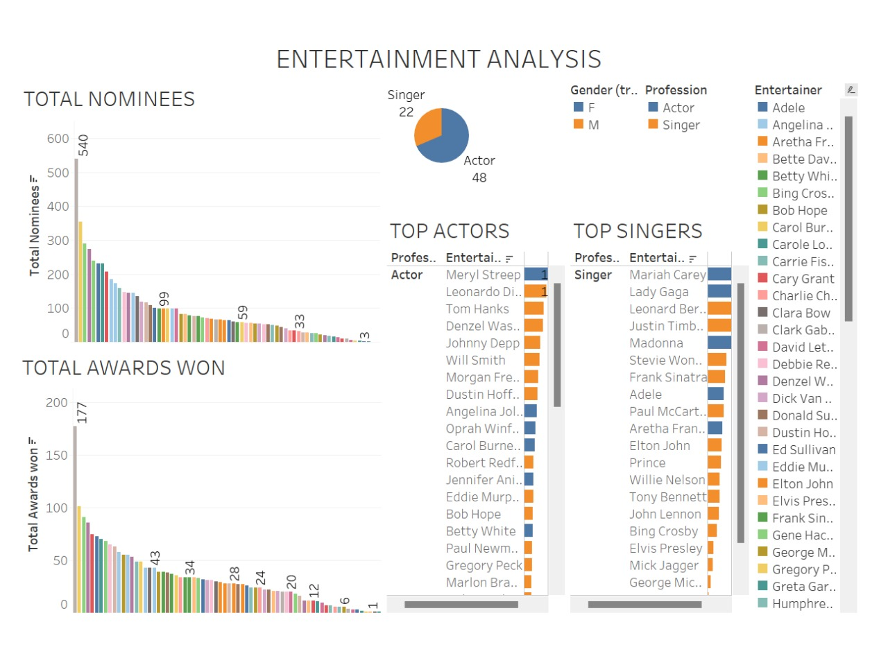

Slide 7
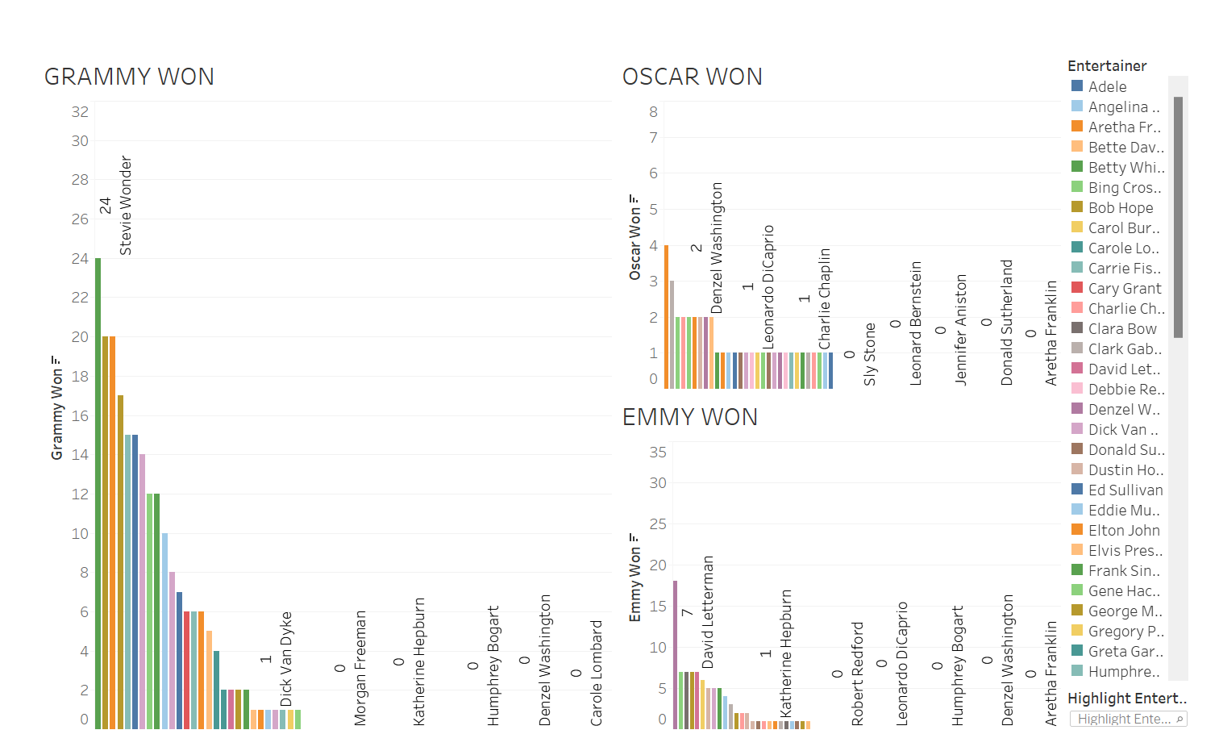

Slide 8
Explanation Insight
Entertainer Meryl streep was an actor highly nominated for 540 times and won 177 times award.
Mariah carey is the top singer in the entertainment industry she won 75 award.
Compared to singers, actor are high in numbers.

Slide 9
THANK YOU

Slide 10
UNIFIED MENTOR INTERNSHIP
Details:
1 Month of duration- DATA ANALYST
Name: Abinaya T
Internship ID: UMIP3526
E-mail: suje.g932@gmail.com
Duration: February 1 to March 2

